Slide 1

Revitalizing iDC TV Inc.'s Pricing Strategy
A Deep Dive into Competitive Analysis & Reflection
Presented by: Issy, Yuan, Tommy
Supervised by: Ci, Jason

Slide 2
Introduction
In a competitive landscape that's constantly evolving, iDC TV Inc. has faced a temporary decline in sales in the first half of 2023. We've identified the root causes, and now we're on a mission to regain our market leadership.
Our Goal: Our primary objective is to revitalize our market position by comprehending our competitors' pricing strategies, refining our own pricing approach, and harnessing data-driven insights.

Slide 3
Introduction
Data Acquisition: Web Scraping
Data Pipeline Development: Efficient ETL Process/ Integration/ Automation
Database Design: Structured SQL Database/ Comprehensive Schema/ Performance Optimization
Data Analysis: Descriptive Analysis/ Univariate Analysis/ Correlation Analysis

Slide 4
Sales Performance Overview
The decline in our sales can be attributed to two key factors:
First, our competitors have been implementing aggressive promotional strategies that have temporarily altered the market dynamics.
Second, we have identified that our own lack of a well-defined pricing strategy has left us at a disadvantage.

Slide 5
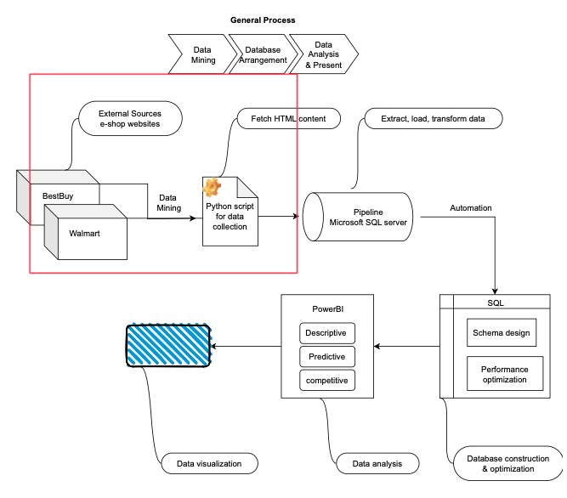
Work Process: Web Scraping
Best Buy Web Scraping:
Tech stack
Periodic data collecting
Data points

Slide 6
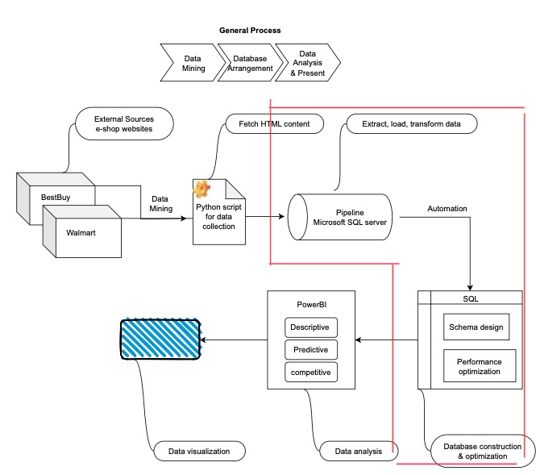
Work Process: Notebook & Data Management
Data Management:
Python
Sql
Online DB:
Schema relations

Slide 7
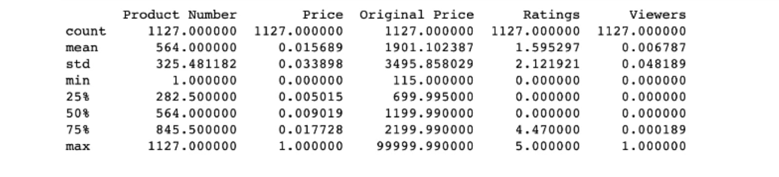
Analysis & Insights
Descriptive Analysis:
All variables have a count of 1127
The Original Price column has a vast range, , going up to 99999.990
The Ratings column ranges from 0 to 5
About half of the TVs have no viewers & Only a few TVs might have a larger viewership
The large standard deviation in the Original Price column

Slide 8
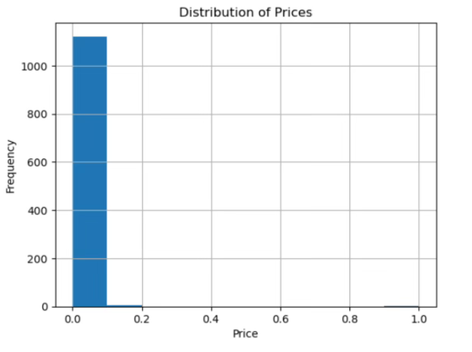
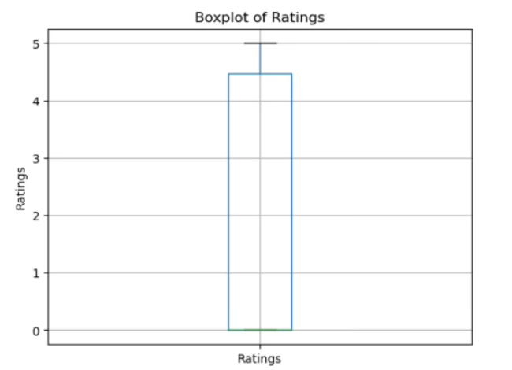
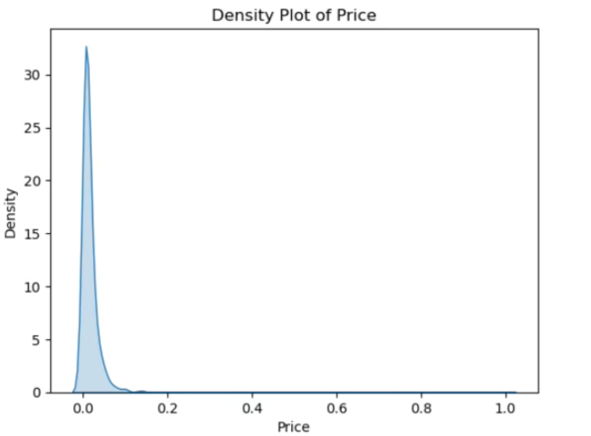
Analysis & Insights
Univariate Analysis:
The majority of products are priced in the lower range (close to 0.0 to 0.2)
The median rating is around 4.5 & The majority of ratings lie between 4 and 5
The majority of the product prices are clustered around the 0.0 mark, with a sharp peak

Slide 9
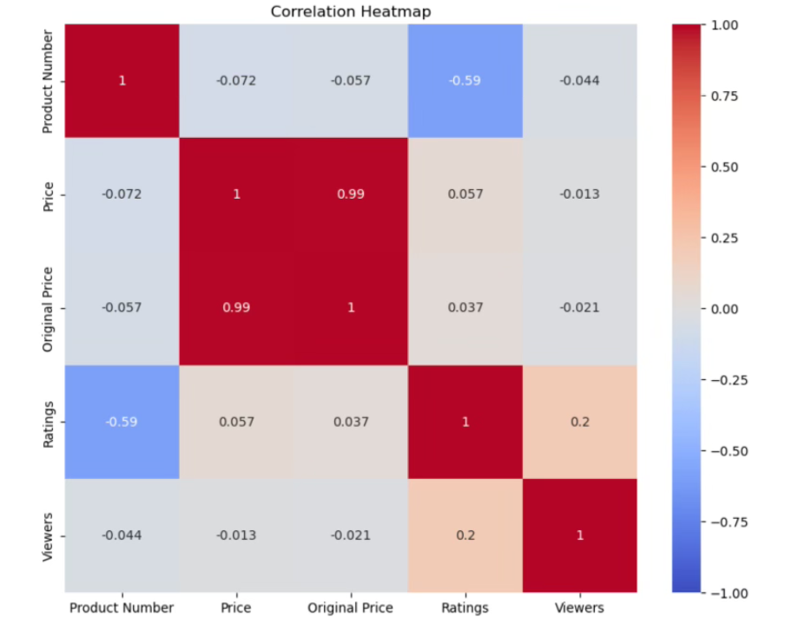
Visualization & Strategy Formulation
Correlation Analysis:
Diagonal Elements
Product Number and Ratings
Price and Original Price
Ratings and Viewers
Product Number and other columns
Price, Original Price, and Viewers

Slide 10
Reflection: Take-aways
Technical Skill Enhancement
Strategic Thinking
Project Management
Communication Skills
Collaboration
Problem-Solving

Slide 11
Reflection: Difficulties & Challenges
Tech Challenges:
Learning and Implementing Python Web Crawling Tools
Handling Complex Web Pages
Environment Configuration
Addressing Missing Data
Learning and Using Microsoft Azure
Identifying Data Relationships
Other Challenges:
Communication
Teamwork

Slide 12
Conclusion
Product Distribution:1,127 products
Price Distribution: Most products are priced low & The mean price of the products, after normalization, is approximately 0.015689
Rating Distribution: A large portion of the products has high ratings
Viewership: Many products have low viewership
Correlations: There's a strong positive correlation between the Price and Original Price (around 0.99), which is expected as the original price would typically be close to the selling price, except for discounted items
Notes:
Our project has equipped iDC TV Inc. with a data-driven advantage to address the recent sales decline. We've harvested pricing data, developed efficient data pipelines, and designed a structured database. Our data analysis has delivered vital insights to regain market leadership.

Slide 13
Future Outlook
Engagement Opportunities: There's potential to enhance marketing strategies or promotional activities to boost viewership and, consequently, sales.
Pricing Strategy: There might be an opportunity to introduce premium products or revisit the pricing strategy for existing products to increase profit margins.
Product Reviews: Efforts could be made to encourage customers to leave reviews, especially for newer products, as ratings can influence purchase decisions and improve product visibility.
Product Launch Strategy: It might be beneficial to study the negative correlation between Product Number and Ratings further.
Notes:
Expect ongoing monitoring, informed decision-making, and a competitive edge as we utilize predictive insights. iDC TV Inc. is now poised for agile growth, ensuring continued success in a dynamic industry.

Slide 14
Q & A

